Slide 1
Traffic Signs Recognition
Jumana Lightwala – C0892358
Niral Shah – C0894470
Shreyash Banawala - C0891309
Shivam Patel - C0907758

Slide 2
Table of contents
01
02
03
04
Introduction
Technologies
Preparation Steps
Conclusion

Slide 3
Traffic signs you must know
Stop signs
Yield signs
Speed signs
Mercury is the closest planet to the Sun and the smallest one in the entire Solar System
Venus has a beautiful name and is the second planet from the Sun. It is hot, even hotter than Mercury
Earth is the third planet from the Sun and the only one that harbors life in the Solar System

Slide 4
Technologies Used
Keras
Convolutional Neural Networks
Build a CNN model to classify the images into their respective categories.
Keras used to keep our trained model. TensorFlow
Open CV
Flask
easy-to-use interface for working with image and video processing functions
Flask provides built-in development server and a fast debugger provided

Slide 5
01
Introduction
Two major factors that contribute to traffic accidents, particularly in inclement weather, are speeding and failing to see traffic signs. TrafficSignGuard seeks to solve these issues by developing a CNN-based traffic sign recognition system that increases road safety by increasing identification accuracy.

Slide 6
Traffic Signal Recognition Insights:
Data Preparation: Clean, resize, and augment dataset.
Model: CNNs, Keras with Sklearn and TensorFlow.
Transfer Learning: Adapt pre-trained models.
Augmentation: Enhance diversity.
Tuning: Optimize hyperparameters.
Metrics: Assess accuracy, precision.

Slide 7
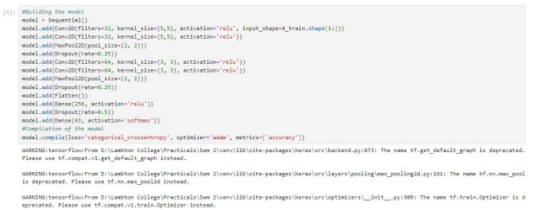
Model Binding

Slide 8
23,000+
Number of Images for our model training(16500) and testing(16500)

Slide 9
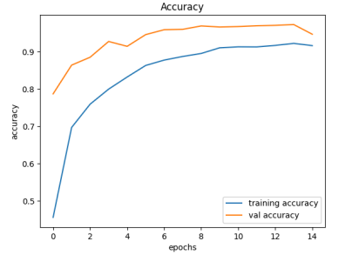

Slide 10
Conclusion
Despite challenges, the TrafficSignGuard project is making steady progress towards enhancing road safety through improved traffic sign recognition capabilities.
With continued dedication and collaboration, the team remains committed to overcoming obstacles and delivering a robust solution.

Slide 11
Future Goals
Looking ahead, the team is poised to tackle the following tasks:
Keep updating the model to get more accuracy.
Development of User Interface with Flask
Model training and bug fixing accordingly
Integration of front-end, back-end and jupyter notebook.

Slide 12


Slide 13
Thank You
Do you have any questions?

